Slide 1
Machine learning: Methods and Tools
Wolfgang Ecker, Elena Zennaro, Lorenzo Servadei

Slide 2
Reinforcement Learning

Slide 3
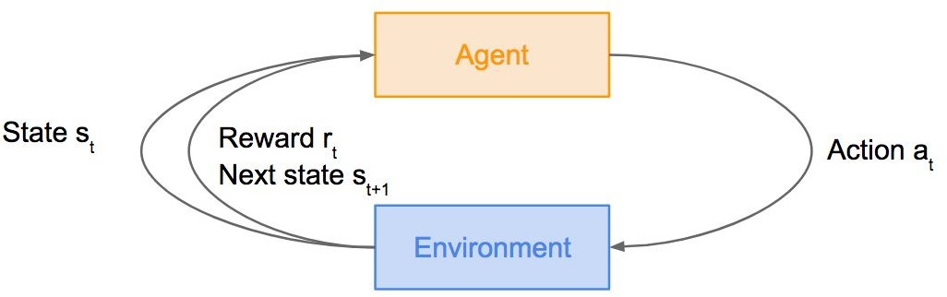
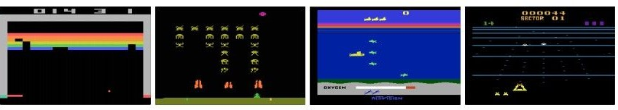
Reinforcement Learning
Problems involving an agent interacting with an environment, which provides numeric reward signals
Goal: Learn how to take actions in order to maximize reward
Lecture 14 -
3

Slide 4
Outline
What is Reinforcement Learning?
Markov Decision Processes
Q-Learning
Policy Gradients
Alpha Go Zero
MORL
Lecture 14 -
4

Slide 5
Reinforcement Learning
Agent
Environment
Lecture 14 - 5

Slide 6
Reinforcement Learning
Agent
State s_{t}
Environment
Lecture 14 - 6

Slide 7
Reinforcement Learning
Agent
State s_{t}
Action a_{t}
Environment
Lecture 14 - 7

Slide 8
Reinforcement Learning
Agent
State s_{t}
Reward r_{t}
Action a_{t}
Environment
Lecture 14 - 8

Slide 9
Reinforcement Learning
Agent
State s_{t}
Reward r_{t}
Action
a
Environment
t
Next state
S_{t+1}
Lecture 14 - 9

Slide 10
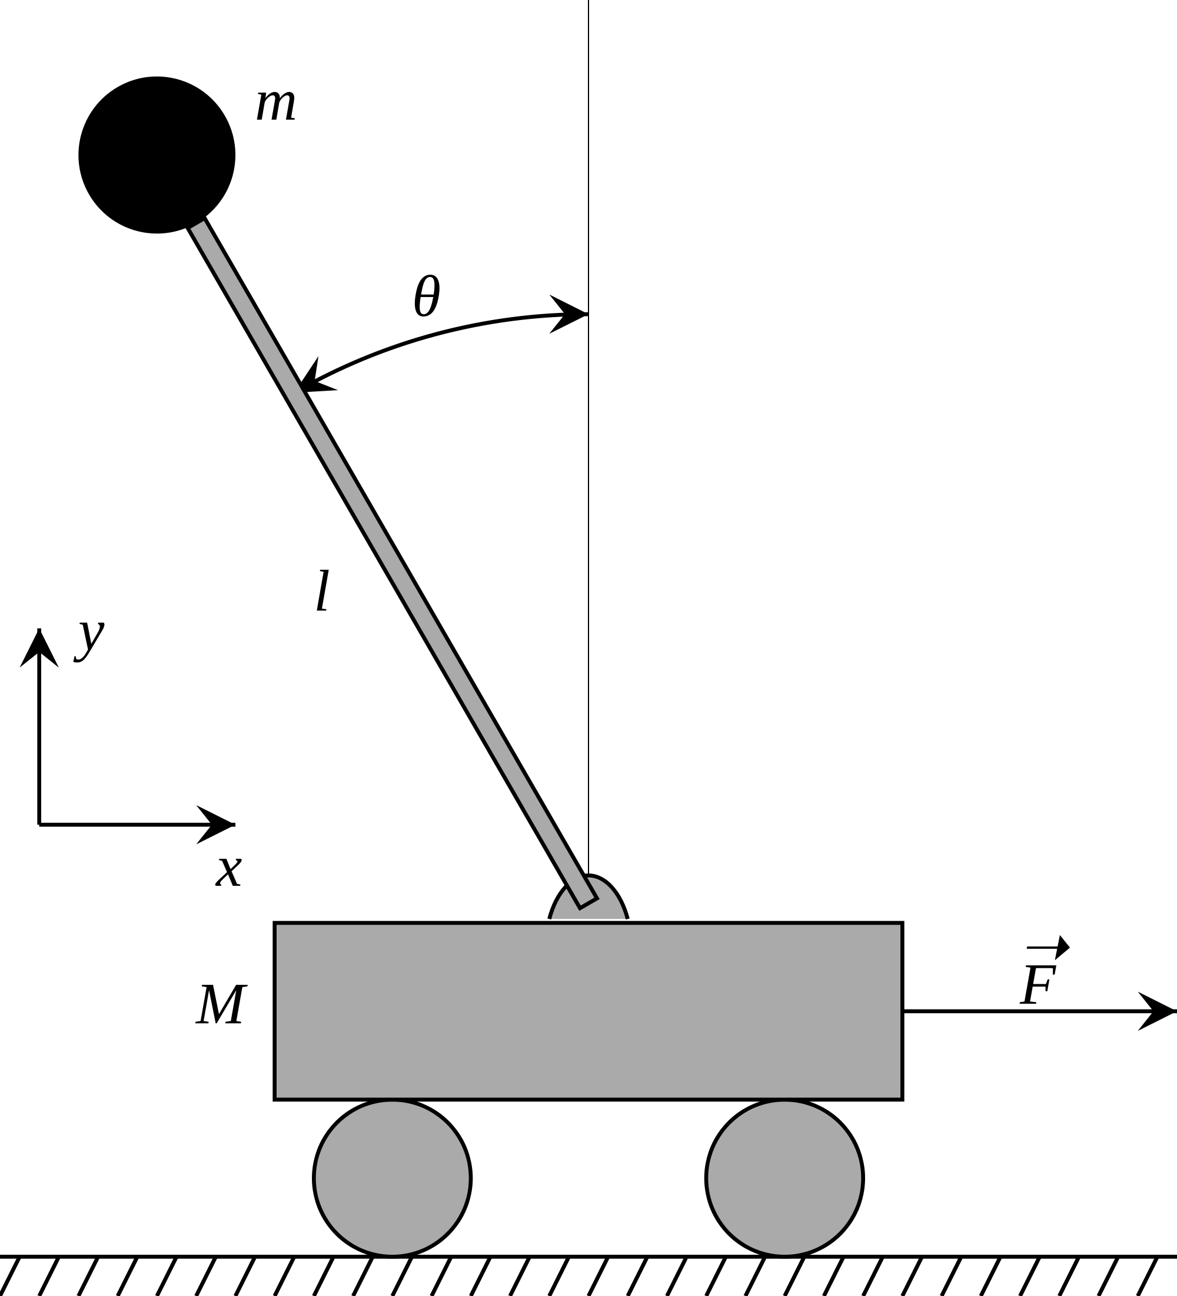
Cart-Pole Problem
Objective: Balance a pole on top of a movable cart
State: angle, angular speed, position, horizontal velocity
Action: horizontal force applied on the cart
Reward: 1 at each time step if the pole is upright
This image is CC0 public domain
Lecture 14 -

Slide 11
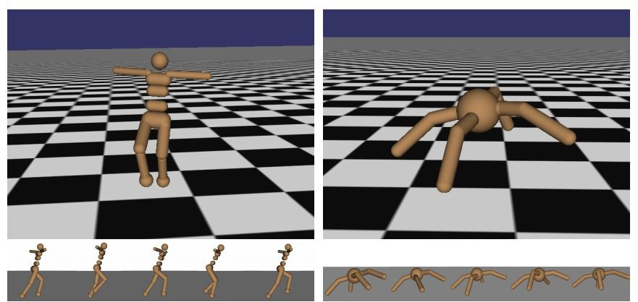
Robot Locomotion
Objective: Make the robot move forward
State: Angle and position of the joints Action: Torques applied on joints Reward: 1 at each time step upright + forward movement
Lecture 14 -

Slide 12
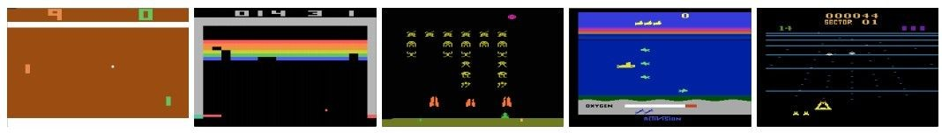
Atari Games
Objective: Complete the game with the highest score
State: Raw pixel inputs of the game state
Action: Game controls e.g. Left, Right, Up, Down
Reward: Score increase/decrease at each time step
Lecture 14 -

Slide 13
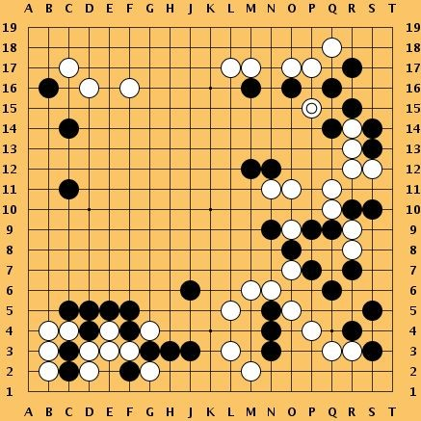
Go
Objective: Win the game!
State: Position of all pieces
Action: Where to put the next piece down
Reward: 1 if win at the end of the game, 0 otherwise
This image is CC0 public domain
Lecture 14 -

Slide 14
How can we mathematically formalize the RL problem?
Agent
Reward r_{t}
Action a_{t}
State s_{t}
Environment
Next state s_{t+1}

Slide 15

Markov Decision Process
Discrete time stochastic control process
Mathematical formulation of the RL problem
Markov property: Current state completely characterises the state of the world
Defined by:
: set of possible states
: set of possible actions
: distribution of reward given (state, action) pair
: transition probability i.e. distribution over next state given (state, action) pair
: discount factor
Notes:
Conditional probability distribution of future states of the process (conditional on both past and present states) depends only upon the present state

Slide 16

Markov Decision Process
At time step t=0, environment samples initial state s₀ ~ p(s₀)
Then, for t=0 until done:
Agent selects action a_{t}
Environment samples reward r_{t} ~ R( . | s_{t}, a_{t})
Environment samples next state s_{t+1} ~ P( . | s_{t}, a_{t})
Agent receives reward r_{t} and next state s_{t+1}
A policy u is a function from S to A that specifies what action to take in each state
Objective: find policy u* that maximizes cumulative discounted reward:

Slide 17
A simple MDP: Grid World
actions = {
states
right
left
up
down
★
 |  |  | ★
Set a negative “reward” for each transition
(e.g. r = -1)
}
Objective: reach one of terminal states (greyed out) in least number of actions

Slide 18



A simple MDP: Grid World
★
 |  |  | ★
★
 |  |  | ★
Random Policy
Optimal Policy

Slide 19
The optimal policy u*
We want to find optimal policy u* that maximizes the sum of rewards.
How do we handle the randomness (initial state, transition probability…)?

Slide 20

The optimal policy u*
We want to find optimal policy u* that maximizes the sum of rewards.
How do we handle the randomness (initial state, transition probability…)? Maximize the expected sum of rewards!
Formally:

Slide 21
Definitions: Value function and Q-value function
Following a policy produces sample trajectories (or paths) s₀, a₀, r₀, s₁, a₁, r₁, …

Slide 22

Definitions: Value function and Q-value function
Following a policy produces sample trajectories (or paths) s₀, a₀, r₀, s₁, a₁, r₁, …
How good is a state?
The value function at state s, is the expected cumulative reward from following the policy from state s:

Slide 23

Definitions: Value function and Q-value function
Following a policy produces sample trajectories (or paths) s₀, a₀, r₀, s₁, a₁, r₁, …
How good is a state?
The value function at state s, is the expected cumulative reward from following the policy from state s:
How good is a state-action pair?
The Q-value function at state s and action a, is the expected cumulative reward from taking action a in state s and then following the policy:

Slide 24
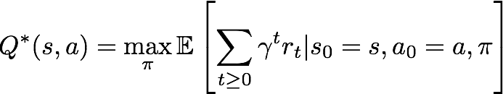
Bellman equation
The optimal Q-value function Q* is the maximum expected cumulative reward achievable from a given (state, action) pair:

Slide 25


Bellman equation
The optimal Q-value function Q* is the maximum expected cumulative reward achievable from a given (state, action) pair:
Q* satisfies the following Bellman equation:
Intuition: if the optimal state-action values for the next time-step Q*(s’,a’) are known, then the optimal strategy is to take the action that maximizes the expected value of

Slide 26
Bellman equation
The optimal Q-value function Q* is the maximum expected cumulative reward achievable from a given (state, action) pair:
Q* satisfies the following Bellman equation:
Intuition: if the optimal state-action values for the next time-step Q*(s’,a’) are known, then the optimal strategy is to take the action that maximizes the expected value of
The optimal policy u* corresponds to taking the best action in any state as specified by Q*

Slide 27

Solving for the optimal policy
Value iteration algorithm: Use Bellman equation as an iterative update
Q_{i} will converge to Q* as i -> infinity

Slide 28
Solving for the optimal policy
Value iteration algorithm: Use Bellman equation as an iterative update
Q_{i} will converge to Q* as i -> infinity
What’s the problem with this?

Slide 29
Solving for the optimal policy
Value iteration algorithm: Use Bellman equation as an iterative update
Q_{i} will converge to Q* as i -> infinity
What’s the problem with this?
Not scalable. Must compute Q(s,a) for every state-action pair. If state is e.g. current game state pixels, computationally infeasible to compute for entire state space!

Slide 30
Solving for the optimal policy
Value iteration algorithm: Use Bellman equation as an iterative update
Q_{i} will converge to Q* as i -> infinity
What’s the problem with this?
Not scalable. Must compute Q(s,a) for every state-action pair. If state is e.g. current game state pixels, computationally infeasible to compute for entire state space!
Solution: use a function approximator to estimate Q(s,a). E.g. a neural network!

Slide 31

Solving for the optimal policy: Q-learning
Q-learning: Use a function approximator to estimate the action-value function

Slide 32
Solving for the optimal policy: Q-learning
Q-learning: Use a function approximator to estimate the action-value function
If the function approximator is a neural network => deep q-learning!

Slide 33
Solving for the optimal policy: Q-learning
Q-learning: Use a function approximator to estimate the action-value function
function parameters (weights)
If the function approximator is a neural network => deep q-learning!

Slide 34
Solving for the optimal policy: Q-learning
Remember: want to find a Q-function that satisfies the Bellman Equation:

Slide 35

Solving for the optimal policy: Q-learning
Remember: want to find a Q-function that satisfies the Bellman Equation:
Forward Pass Loss function:
where
Notes:
How can an RL agent learn from an environment with a non-Markov reward function

Slide 36
Solving for the optimal policy: Q-learning
Remember: want to find a Q-function that satisfies the Bellman Equation:
Forward Pass Loss function:
where
Backward Pass
Gradient update (with respect to Q-function parameters θ):

Slide 37
Solving for the optimal policy: Q-learning
Remember: want to find a Q-function that satisfies the Bellman Equation:
Loss function:
Iteratively try to make the Q-value
where
close to the target value (y ) it
should have, if Q-function
i
corresponds to optimal Q* (and optimal policy u*)
Backward Pass
Gradient update (with respect to Q-function parameters θ):

Slide 38
Case Study: Playing Atari Games
[Mnih et al. NIPS Workshop 2013; Nature 2015]
Objective: Complete the game with the highest score
State: Raw pixel inputs of the game state
Action: Game controls e.g. Left, Right, Up, Down
Reward: Score increase/decrease at each time step

Slide 39

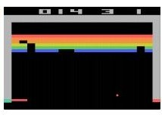
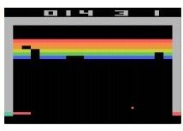
Q-network Architecture
[Mnih et al. NIPS Workshop 2013; Nature 2015]
:
neural network with weights
FC-4 (Q-values)
FC-256
32 4x4 conv, stride 2
16 8x8 conv, stride 4
Current state s_{t}: 84x84x4 stack of last 4 frames
(after RGB->grayscale conversion, downsampling, and cropping)

Slide 40
Q-network Architecture
[Mnih et al. NIPS Workshop 2013; Nature 2015]
:
neural network with weights
FC-4 (Q-values)
FC-256
32 4x4 conv, stride 2
16 8x8 conv, stride 4
Input: state s_{t}
Current state s_{t}: 84x84x4 stack of last 4 frames
(after RGB->grayscale conversion, downsampling, and cropping)

Slide 41
Q-network Architecture
[Mnih et al. NIPS Workshop 2013; Nature 2015]
:
neural network with weights
FC-4 (Q-values)
FC-256
32 4x4 conv, stride 2
Familiar conv layers, FC layer
16 8x8 conv, stride 4
Current state s_{t}: 84x84x4 stack of last 4 frames
(after RGB->grayscale conversion, downsampling, and cropping)

Slide 42
Q-network Architecture
[Mnih et al. NIPS Workshop 2013; Nature 2015]
:
neural network with weights
Last FC layer has 4-d
output (if 4 actions), corresponding to Q(s_{t}, a₁), Q(s_{t}, a₂), Q(s_{t}, a₃), Q(s_{t},a₄)
FC-4 (Q-values)
FC-256
32 4x4 conv, stride 2
16 8x8 conv, stride 4
Current state s_{t}: 84x84x4 stack of last 4 frames
(after RGB->grayscale conversion, downsampling, and cropping)

Slide 43
Q-network Architecture
[Mnih et al. NIPS Workshop 2013; Nature 2015]
:
neural network with weights
Last FC layer has 4-d
output (if 4 actions), corresponding to Q(s_{t}, a₁), Q(s_{t}, a₂), Q(s_{t}, a₃), Q(s_{t},a₄)
FC-4 (Q-values)
FC-256
32 4x4 conv, stride 2
16 8x8 conv, stride 4
Number of actions between 4-18 depending on Atari game
Current state s_{t}: 84x84x4 stack of last 4 frames
(after RGB->grayscale conversion, downsampling, and cropping)

Slide 44
Q-network Architecture
[Mnih et al. NIPS Workshop 2013; Nature 2015]
:
neural network with weights
Last FC layer has 4-d
output (if 4 actions), corresponding to Q(s_{t}, a₁), Q(s_{t}, a₂), Q(s_{t}, a₃), Q(s_{t},a₄)
FC-4 (Q-values)
FC-256
32 4x4 conv, stride 2
A single feedforward pass to compute Q-values for all actions from the current state => efficient!
16 8x8 conv, stride 4
Number of actions between 4-18 depending on Atari game
Current state s_{t}: 84x84x4 stack of last 4 frames
(after RGB->grayscale conversion, downsampling, and cropping)

Slide 45
Training the Q-network: Experience Replay
[Mnih et al. NIPS Workshop 2013; Nature 2015]
Learning from batches of consecutive samples is problematic:
Samples are correlated => inefficient learning
Current Q-network parameters determines next training samples (e.g. if maximizing action is to move left, training samples will be dominated by samples from left-hand size) => can lead to bad feedback loops

Slide 46
Training the Q-network: Experience Replay
[Mnih et al. NIPS Workshop 2013; Nature 2015]
Learning from batches of consecutive samples is problematic:
Samples are correlated => inefficient learning
Current Q-network parameters determines next training samples (e.g. if maximizing action is to move left, training samples will be dominated by samples from left-hand size) => can lead to bad feedback loops
Address these problems using experience replay
Continually update a replay memory table of transitions (s_{t}, a_{t}, r_{t}, s_{t+1}) as game (experience) episodes are played
Train Q-network on random minibatches of transitions from the replay memory, instead of consecutive samples

Slide 47
Training the Q-network: Experience Replay
[Mnih et al. NIPS Workshop 2013; Nature 2015]
Learning from batches of consecutive samples is problematic:
Samples are correlated => inefficient learning
Current Q-network parameters determines next training samples (e.g. if maximizing action is to move left, training samples will be dominated by samples from left-hand size) => can lead to bad feedback loops
Address these problems using experience replay
Continually update a replay memory table of transitions (s_{t}, a_{t}, r_{t}, s_{t+1}) as game (experience) episodes are played
Train Q-network on random minibatches of transitions from the replay memory,
instead of consecutive samples
Each transition can also contribute to multiple weight updates
=> greater data efficiency

Slide 48
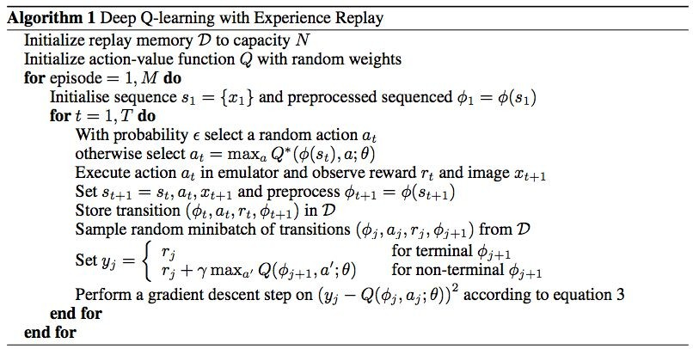
Putting it together: Deep Q-Learning with Experience Replay

Slide 49
Putting it together: Deep Q-Learning with Experience Replay
Initialize replay memory, Q-network

Slide 50
Putting it together: Deep Q-Learning with Experience Replay
[Mnih et al. NIPS Workshop 2013; Nature 2015]
Play M episodes (full games)

Slide 51
Putting it together: Deep Q-Learning with Experience Replay
[Mnih et al. NIPS Workshop 2013; Nature 2015]
Initialize state (starting game screen pixels) at the beginning of each episode

Slide 52
Putting it together: Deep Q-Learning with Experience Replay
[Mnih et al. NIPS Workshop 2013; Nature 2015]
For each timestep t of the game

Slide 53
Putting it together: Deep Q-Learning with Experience Replay
[Mnih et al. NIPS Workshop 2013; Nature 2015]
With small probability, select a random action (explore), otherwise select greedy action from current policy

Slide 54
Putting it together: Deep Q-Learning with Experience Replay
[Mnih et al. NIPS Workshop 2013; Nature 2015]
Take the action (a_{t}), and observe the reward r_{t} and next state s_{t+1}

Slide 55
Putting it together: Deep Q-Learning with Experience Replay
[Mnih et al. NIPS Workshop 2013; Nature 2015]
Store transition in
replay memory

Slide 56
Putting it together: Deep Q-Learning with Experience Replay
[Mnih et al. NIPS Workshop 2013; Nature 2015]
Experience Replay:
Sample a random minibatch of transitions from replay memory and perform a gradient descent step

Slide 57
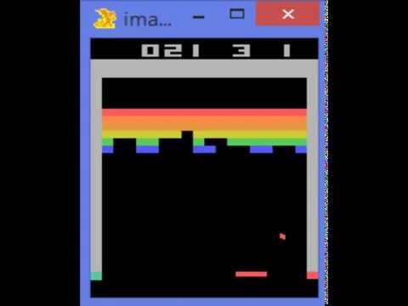
https://www.youtube.com/watch?v=V1eYniJ0Rnk
Video by Károly Zsolnai-Fehér. Reproduced with permission.

Slide 58
Policy Gradients
What is a problem with Q-learning?
The Q-function can be very complicated!
Example: a robot grasping an object has a very high-dimensional state => hard to learn exact value of every (state, action) pair

Slide 59
Policy Gradients
What is a problem with Q-learning?
The Q-function can be very complicated!
Example: a robot grasping an object has a very high-dimensional state => hard to learn exact value of every (state, action) pair
But the policy can be much simpler: just close your hand
Can we learn a policy directly, e.g. finding the best policy from a collection of policies?

Slide 60

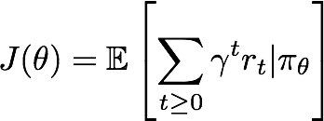
Policy Gradients
Formally, let’s define a class of parametrized policies:
For each policy, define its value:

Slide 61

Policy Gradients
Formally, let’s define a class of parametrized policies:
For each policy, define its value:
We want to find the optimal policy
How can we do this?

Slide 62
Policy Gradients
Formally, let’s define a class of parametrized policies:
For each policy, define its value:
We want to find the optimal policy
How can we do this?
Gradient ascent on policy parameters!

Slide 63
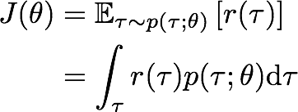

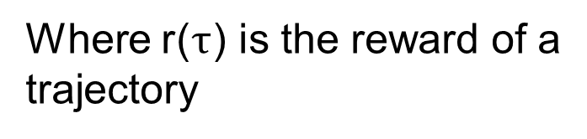
REINFORCE algorithm
Mathematically, we can write:
Where r($τ$) is the reward of a trajectory

Slide 64
REINFORCE algorithm
Expected reward:

Slide 65

REINFORCE algorithm
Expected reward:
Now let’s differentiate this:

Slide 66
REINFORCE algorithm
Expected reward:
Now let’s differentiate this:
Intractable! Gradient of an expectation is problematic when p depends on θ

Slide 67

REINFORCE algorithm
Expected reward:
Now let’s differentiate this:
Intractable! Gradient of an expectation is problematic when p depends on θ
However, we can use a nice trick:

Slide 68
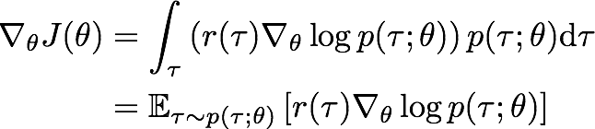
REINFORCE algorithm
Expected reward:
Now let’s differentiate this:
Intractable! Gradient of an expectation is problematic when p depends on θ
However, we can use a nice trick: If we inject this back:
Can estimate with Monte Carlo sampling
Notes:
Definizione di expectation

Slide 69

REINFORCE algorithm
Can we compute those quantities without knowing the transition probabilities?
We have:

Slide 70

REINFORCE algorithm
Can we compute those quantities without knowing the transition probabilities?
We Have:
Thus:

Slide 71

REINFORCE algorithm
Can we compute those quantities without knowing the transition probabilities?
We have:
Doesn’t depend on transition probabilities!
When differentiating:
Thus:

Slide 72

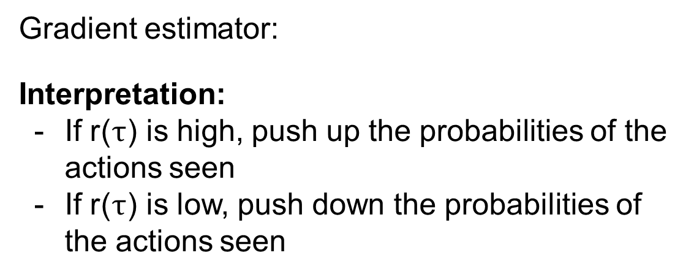
Intuition
Gradient estimator:
Interpretation:
If r($τ$) is high, push up the probabilities of the actions seen
If r($τ$) is low, push down the probabilities of the actions seen

Slide 73
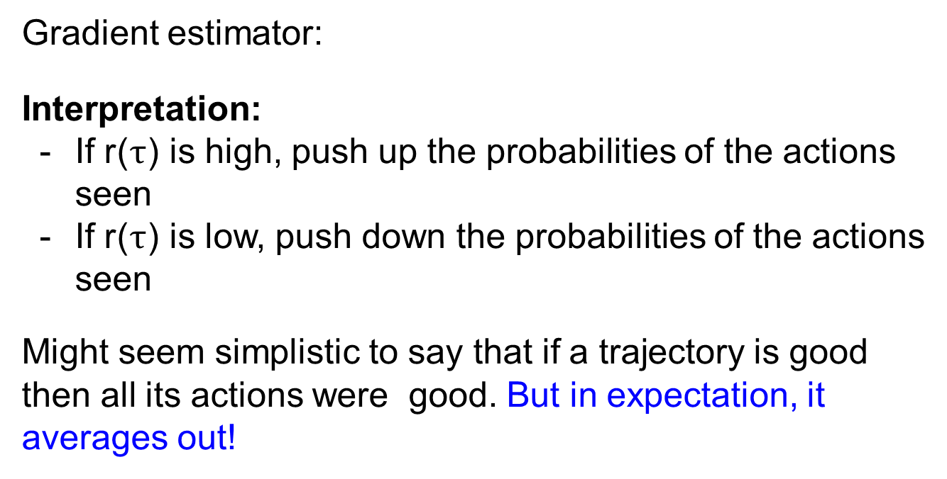
Intuition
Gradient estimator:
Interpretation:
If r($τ$) is high, push up the probabilities of the actions seen
If r($τ$) is low, push down the probabilities of the actions seen
Might seem simplistic to say that if a trajectory is good then all its actions were good. But in expectation, it averages out!

Slide 74
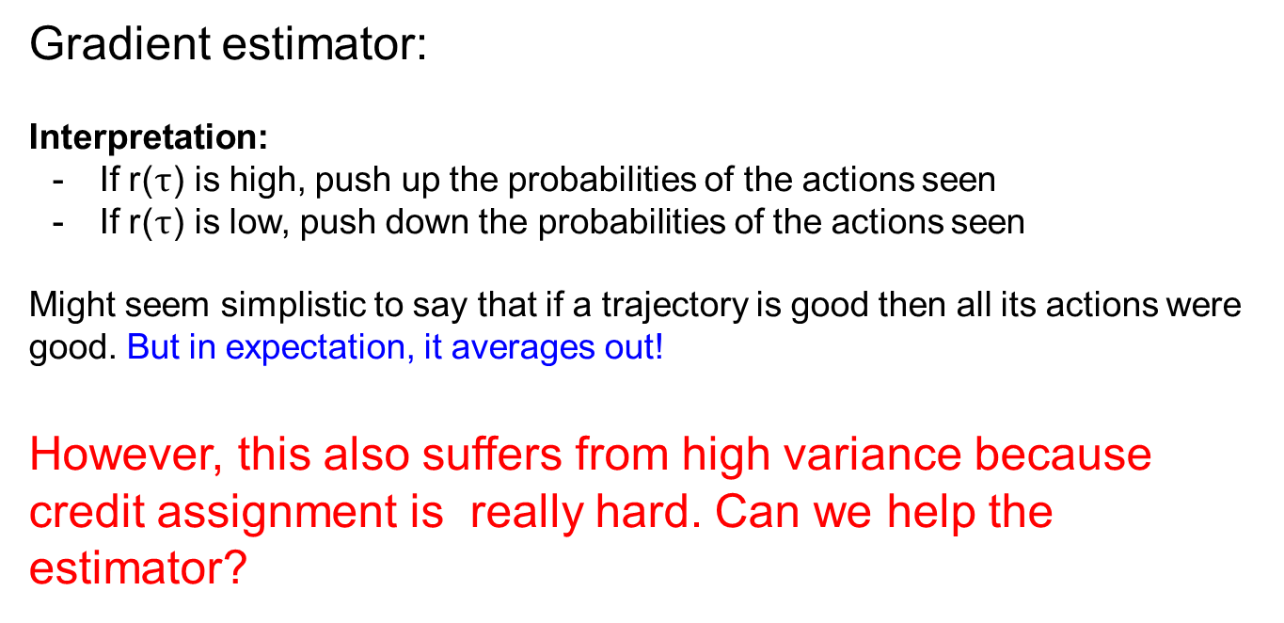
Intuition
Gradient estimator:
Interpretation:
If r($τ$) is high, push up the probabilities of the actions seen
If r($τ$) is low, push down the probabilities of the actions seen
Might seem simplistic to say that if a trajectory is good then all its actions were good. But in expectation, it averages out!
However, this also suffers from high variance because credit assignment is really hard. Can we help the estimator?

Slide 75
Variance reduction
Gradient estimator:

Slide 76
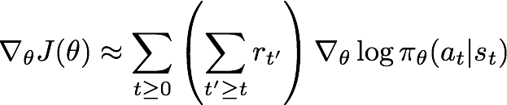
Variance reduction
Gradient estimator:
First idea: Push up probabilities of an action seen, only by the cumulative future reward from that state

Slide 77
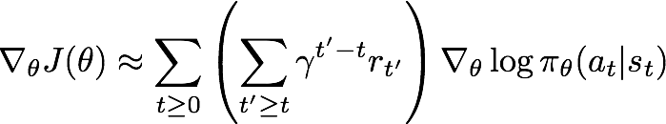
Variance reduction
Gradient estimator:
First idea: Push up probabilities of an action seen, only by the cumulative future reward from that state
Second idea: Use discount factor to ignore delayed effects

Slide 78
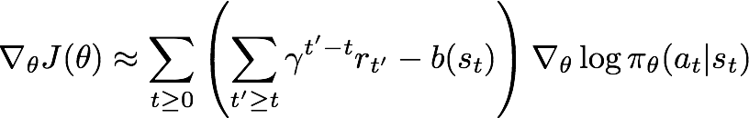
Variance reduction: Baseline
Problem: The raw value of a trajectory isn’t necessarily meaningful. For example, if rewards are all positive, you keep pushing up probabilities of actions.
What is important then? Whether a reward is better or worse than what you expect to get
Idea: Introduce a baseline function dependent on the state. Concretely, estimator is now:

Slide 79
How to choose the baseline?
A simple baseline: constant moving average of rewards experienced so far from all trajectories

Slide 80
How to choose the baseline?
A simple baseline: constant moving average of rewards experienced so far from all trajectories
Variance reduction techniques seen so far are typically used in “Vanilla REINFORCE”

Slide 81
How to choose the baseline?
A better baseline: Want to push up the probability of an action from a state, if this action was better than the expected value of what we should get from that state.
Q: What does this remind you of?

Slide 82
How to choose the baseline?
A better baseline: Want to push up the probability of an action from a state, if this action was better than the expected value of what we should get from that state.
Q: What does this remind you of?
A: Q-function and value function!

Slide 83

How to choose the baseline?
A better baseline: Want to push up the probability of an action from a state, if this action was better than the expected value of what we should get from that state.
Intuitively, we are happy with an action a_{t} in a state s_{t} if is large. On the contrary, we are unhappy with an action if it’s small.

Slide 84

How to choose the baseline?
A better baseline: Want to push up the probability of an action from a state, if this action was better than the expected value of what we should get from that state.
Intuitively, we are happy with an action a_{t} in a state s_{t} if
is large. On the contrary, we are unhappy with an action if it’s small.
Using this, we get the estimator:

Slide 85
Actor-Critic Algorithm
Problem: we don’t know Q and V. Can we learn them?
Yes, using Q-learning! We can combine Policy Gradients and Q-learning by training both an actor (the policy) and a critic (the Q-function).
The actor decides which action to take, and the critic tells the actor how good its action was and how it should adjust
Also alleviates the task of the critic as it only has to learn the values of (state, action) pairs generated by the policy
Can also incorporate Q-learning tricks e.g. experience replay
Remark: we can define by the advantage function how much an action was better than expected

Slide 86



Actor-Critic Algorithm
Initialize policy parameters 8, critic parameters ø
For iteration=1, 2 … do
Sample m trajectories under the current policy
For i=1, …, m do
For t=1, ... , T do
End for

Slide 87
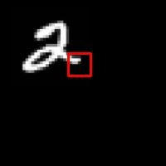
REINFORCE in action: Recurrent Attention Model (RAM)
Objective: Image Classification
Take a sequence of “glimpses” selectively focusing on regions of the image, to predict class
Inspiration from human perception and eye movements
Saves computational resources => scalability
Able to ignore clutter / irrelevant parts of image
State: Glimpses seen so far
Action: (x,y) coordinates (center of glimpse) of where to look next in image
Reward: 1 at the final timestep if image correctly classified, 0 otherwise
glimpse
[Mnih et al. 2014]
Lecture 14 -

Slide 88
REINFORCE in action: Recurrent Attention Model (RAM)
Objective: Image Classification
Take a sequence of “glimpses” selectively focusing on regions of the image, to predict class
Inspiration from human perception and eye movements
Saves computational resources => scalability
Able to ignore clutter / irrelevant parts of image
State: Glimpses seen so far
Action: (x,y) coordinates (center of glimpse) of where to look next in image
Reward: 1 at the final timestep if image correctly classified, 0 otherwise
glimpse
Glimpsing is a non-differentiable operation => learn policy for how to take glimpse actions using REINFORCE Given state of glimpses seen so far, use RNN to model the state and output next action
[Mnih et al. 2014]
Lecture 14 -

Slide 89
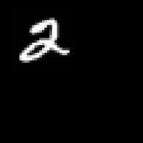
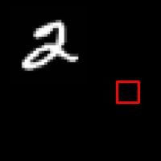
REINFORCE in action: Recurrent Attention Model (RAM)
(x₁, y₁)
Input image
NN
[Mnih et al. 2014]
Lecture 14 -

Slide 90
REINFORCE in action: Recurrent Attention Model (RAM)
(x₁, y₁)
(x₂, y₂)
Input image
NN
NN
[Mnih et al. 2014]
Lecture 14 -

Slide 91
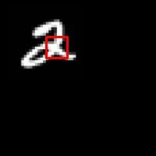
REINFORCE in action: Recurrent Attention Model (RAM)
(x₁, y₁)
(x₂, y₂)
(x₃, y₃)
Input image
NN
NN
NN
[Mnih et al. 2014]
Lecture 14 -

Slide 92
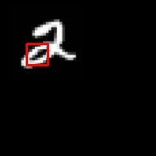
REINFORCE in action: Recurrent Attention Model (RAM)
(x₁, y₁)
(x₂, y₂)
(x₃, y₃)
(x₄, y₄)
Input image
NN
NN
NN
NN
[Mnih et al. 2014]
Lecture 14 -

Slide 93
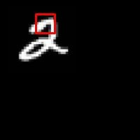
REINFORCE in action: Recurrent Attention Model (RAM)
(x₁, y₁)
(x₂, y₂)
(x₃, y₃)
(x₄, y₄)
(x₅, y₅)
Softmax
Input image
NN
NN
NN
NN
NN
y=2
[Mnih et al. 2014]
Lecture 14 -

Slide 94

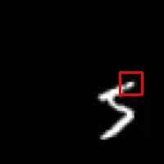
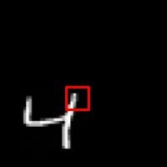
REINFORCE in action: Recurrent Attention Model (RAM)
Has also been used in many other tasks including fine-grained image recognition, image captioning, and visual question-answering!
[Mnih et al. 2014]
10
0
Lecture 14 -

Slide 95
Summary
Policy gradients: very general but suffer from high variance so requires a lot of samples. Challenge: sample-efficiency
Q-learning: does not always work but when it works, usually more sample-efficient. Challenge: exploration
Guarantees:
Policy Gradients: Converges to a local minima of J(θ), often good enough!
Q-learning: Zero guarantees since you are approximating Bellman equation with a complicated function approximator
10
2
Lecture 14 -

Slide 96
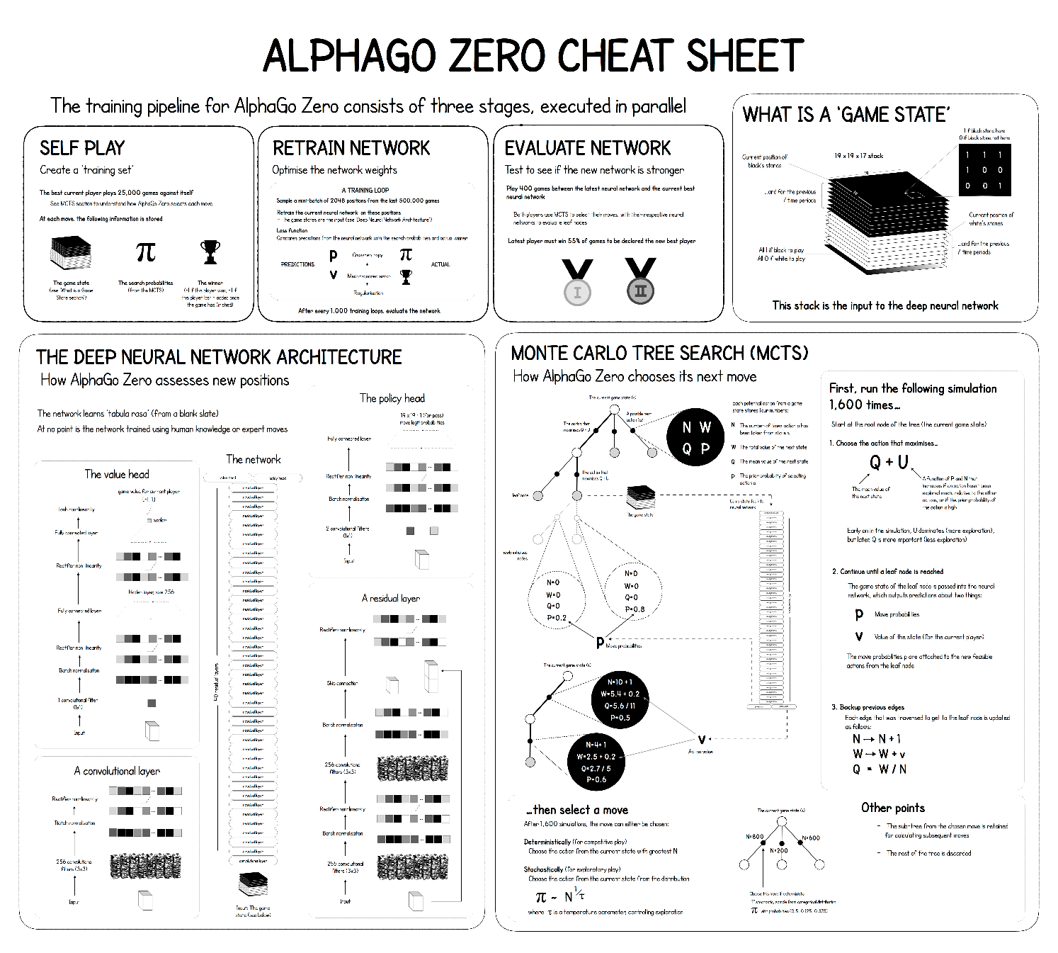
Here
And Here
10
2
Lecture 14 -

Slide 97
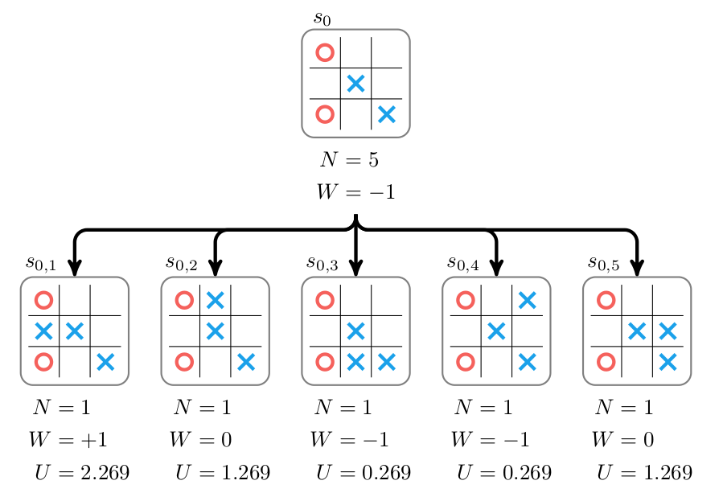
MCTS Principle
10
2
Lecture 14 -

Slide 98
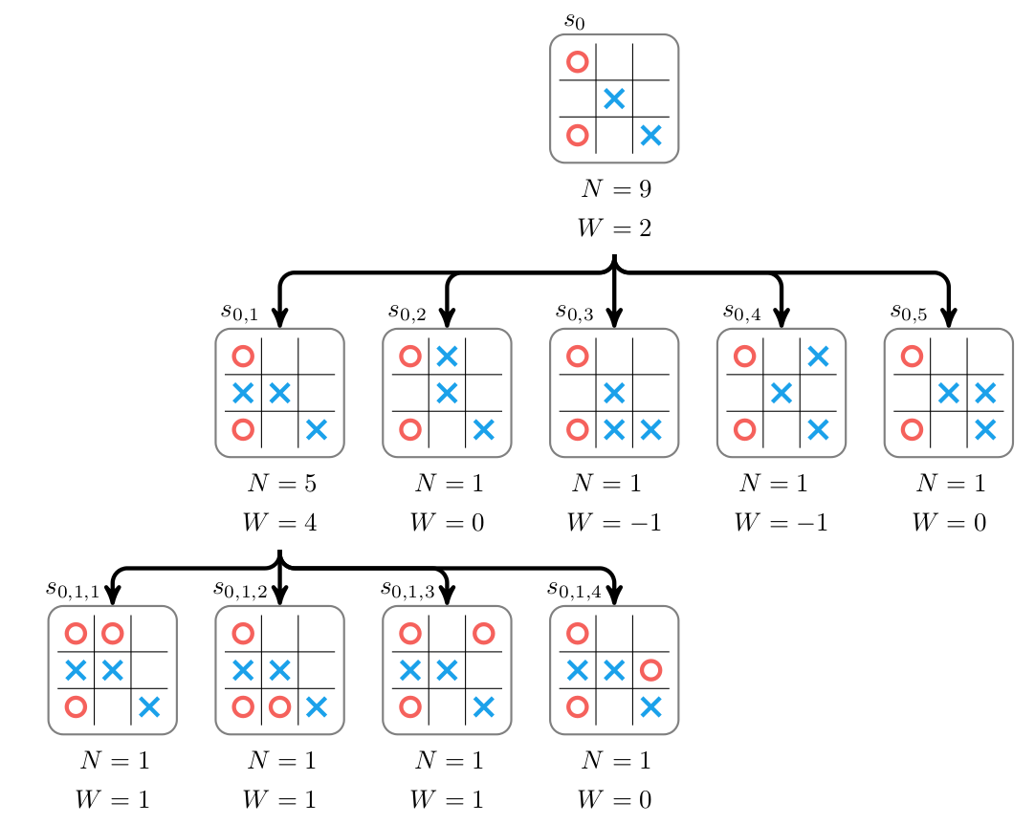
MCTS Principle
10
2
Lecture 14 -

Slide 99
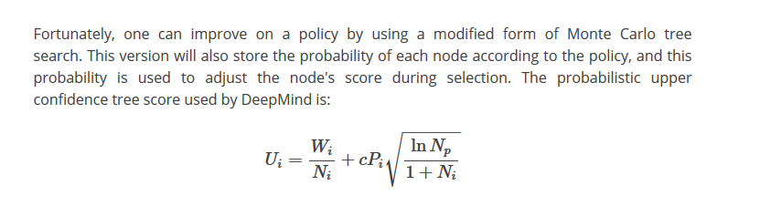

MCTS Principle – AlphaGo Zero
Neural Network
10
2
See Here
Lecture 14 -

Slide 100
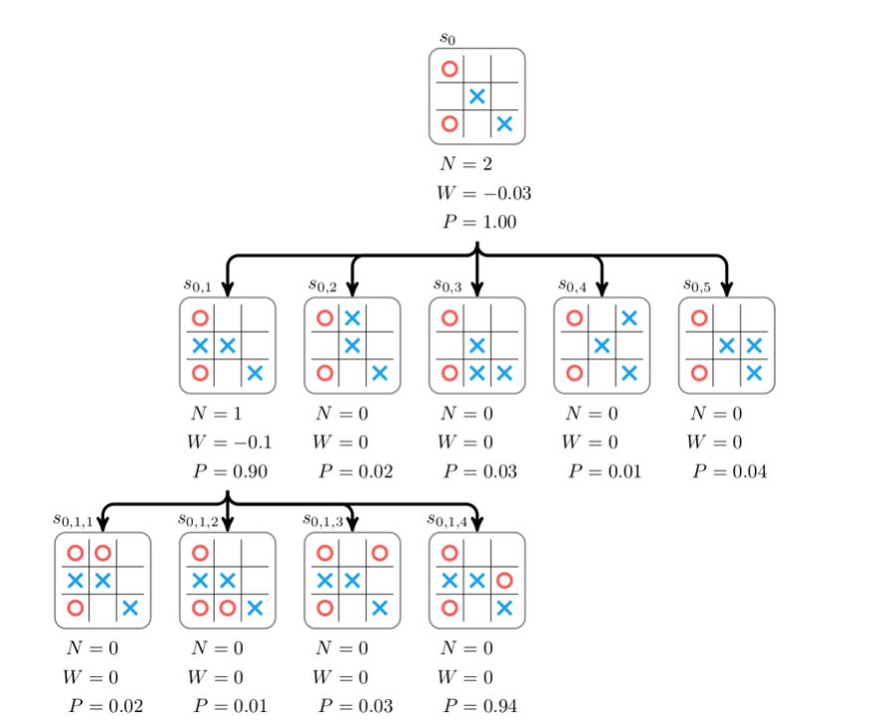
MCTS Principle – AlphaGo Zero
10
2
Lecture 14 -

Slide 101
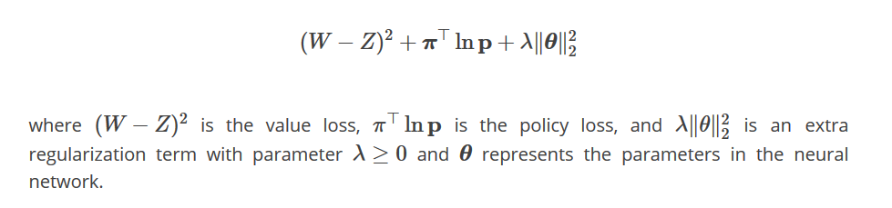
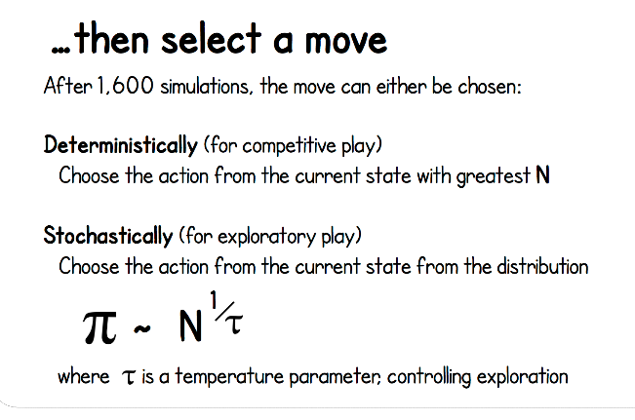
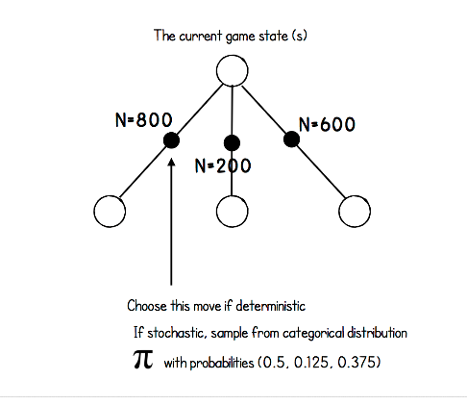
MCTS Principle – AlphaGo Zero
First Train:
10
2
See Here
Lecture 14 -

Slide 102
MORL Algorithms:
Single Policy:
Aim to find the best single policy
which represents the preferences among the multiple objectives as specified by a user or derived
from the problem domain.
Multiple Policy:
The major difference among single-policy approaches
is the way for determining and expressing these preferences. The aim of multiple-policy MORL approaches is to find a set of policies that approximate the Pareto front

Slide 103




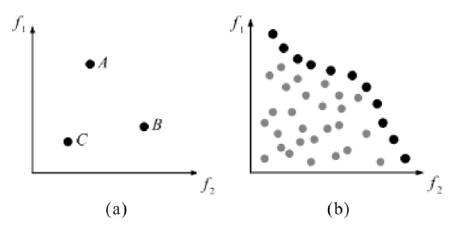
MOO Problems:
Definition:
Pareto Dominance (a) VS Pareto Front (b)

Slide 104
MOO Problems:
When a solution A
is better than another solution C for at least one objective,
and A is also superior or at least equal to C for all the other
objectives, the solution A is said to dominate C. In MOO, it is
preferable to find all the dominating solutions instead of the dominated ones

Slide 105
Sources
http://cs231n.stanford.edu/2017/syllabus.html
https://ieeexplore.ieee.org/stamp/stamp.jsp?arnumber=6509978
https://www.cs.ox.ac.uk/people/nando.defreitas/machinelearning/

